Slide 1
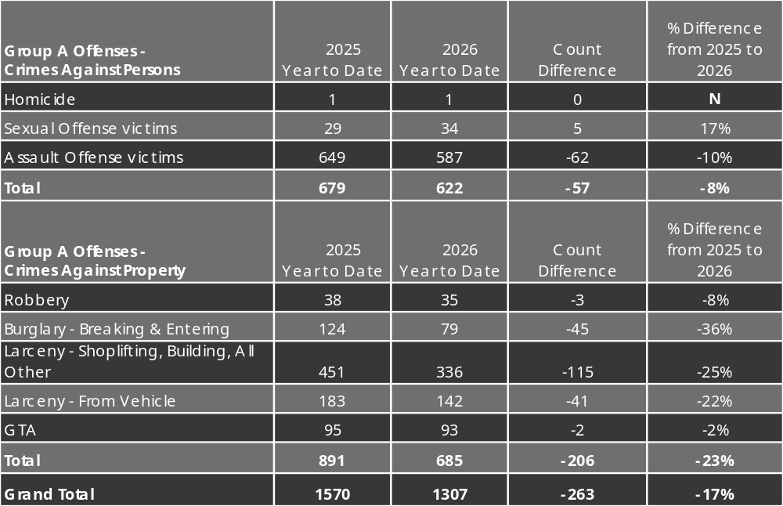
Group A Offenses
Year to Date
01/01/26 – 08/31/26
NC=not calculated

